Slide 1
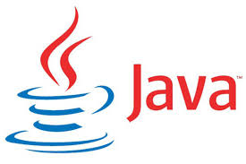
Object Oriented Programming with Java

Slide 2
Module – I: OOPS Concept
Explain - Object Oriented Paradigm
Some definitions of –
Class
Object
Polymorphism
Inheritance
Abstraction
Encapsulation
Advantages of OOP over POP language
Significance of OOPs paradigm

Slide 3
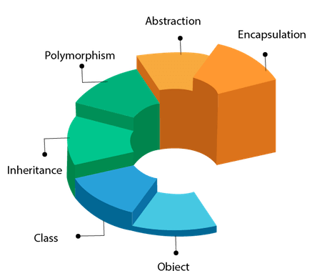
- Object Oriented Programming -
Object Oriented programming is a programming style that is associated with the concept of Class, Objects and various other concepts revolving around these two, like Inheritance, Polymorphism, Abstraction, Encapsulation etc.

Slide 4
- Some definitions -
Class - A class is a blueprint for any functional entity which defines its properties and its functions.
Objects - An Object is an instance of a Class. When a class is defined, no memory is allocated but when it is instantiated (i.e. an object is created) memory is allocated.
Polymorphism - When one task is performed by different ways i.e. known as polymorphism. In C++, Function overloading and Function overriding to achieve polymorphism.
Inheritance - When one object acquires all the properties and behaviors of parent object i.e. known as inheritance. It provides code reusability. It is used to achieve runtime polymorphism.
Abstraction - Hiding internal details and showing functionality is known as abstraction. In C++, we use abstract class and interface to achieve abstraction.
Encapsulation - Binding (or wrapping) code and data together into a single unit is known as encapsulation.

Slide 5
- Advantages of OOP over POP language -
OOPs makes development and maintenance easier where as in Procedure-oriented programming language it is not easy to manage if code grows as project size grows.
OOPs provide data hiding whereas in Procedure-oriented programming language a global data can be accessed from anywhere.
OOPs provide ability to simulate real-world event much more effectively. We can provide the solution of real word problem if we are using the Object-Oriented Programming language.

Slide 6
Significance of OOPs -
OOP offers easy to understand and a clear modular structure for programs.
Objects created for Object-Oriented Programs can be reused in other programs. Thus it saves significant development cost.
Large programs are difficult to write, but if the development and designing team follow OOPS concept then they can better design with minimum flaws.
It also enhances program modularity because every object exists independently.

Slide 7
- Some Questioners -
What is a class in Java?
A class is a group of objects which have common properties. It is a template or blueprint from which objects are created. It is a logical entity. It can't be physical. A class in Java can contain –
Fields
Methods
Constructors
Blocks
Nested class and interface
Object Definitions -
An object is a real-world entity.
An object is a runtime entity.
The object is an entity which has state and behavior.
The object is an instance of a class.

Slide 8
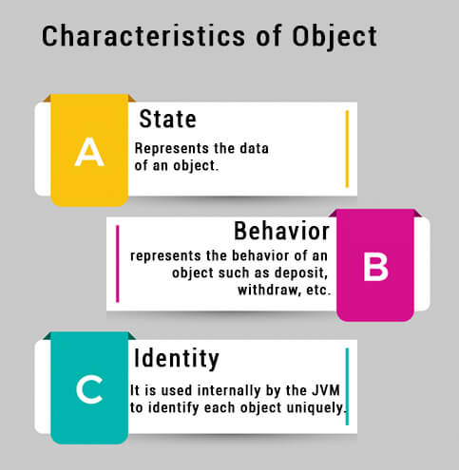
3 ways to initialize object -
There are 3 ways to initialize object in Java.
By reference variable
By method
By constructor

Slide 9
What do you mean by Instantiation?
The term factory typically is used for holding similar kind of objects within it. Generally, an object is created by using information available in the class. It also contains details of an object’s internal data and when an object is brought into existence, is called Instantiation.
“Class is an Object factory” – Explain
The class is a prototype of an object. Each object belonging to a specific class possesses the data and methods defined within the class. It produces objects of similar types. Hence, a class is termed as Object factory.
“Object is an instance of a class” – Explain
An object is an instance of a class. A class is a template or blueprint from which objects are created. So, an object is the instance (result) of a class.
What do you mean by Instance variable in Java?
A variable which is created inside the class but outside the method is known as an instance variable. Instance variable doesn't get memory at compile time. It gets memory at runtime when an object or instance is created. That is why it is known as an instance variable.

Slide 10
“Class is a user defined data type” – Explain
In Java, class is a collection of different types of data elements and their associated behaviors or methods into a single unit.
A class is a composite user-defined data type. Composite data type is based on the fundamental data types.
To access the class elements, the programmer needs to create object of the class.
Object in an instantiation of a class. In terms of variables, the class would be the type and object would be the variable. An object represents data elements and their associated methods together into a single unit.
An object declaration statement has three parts: declaration...
Objects can be used in two ways: by referencing an object's fields and by calling its methods.
Java provides access specifiers to control the accessibility of the class elements outside its class body.
Data members or member functions specified as public can be used outside a class also. Data members or member functions specified as private can be used within a class only. Protected elements are accessible only inside the same class and by the derived class.

Slide 11
- Assignments -

Slide 12
Module – II: An Overview of Java
Explain – Java
Explain – Java Features
Explain – JVM
Idea on Java Development Kit (JDK)
Idea on Java Runtime Environment (JRE)
Comparison between Java & C++
Java programs execution process using JDK

Slide 13
Java –
What is Java?
Java is a programming language and a computing platform for application development. It was first released by Sun Microsystems in 1995 and later acquired by Oracle Corporation. It is one of the most used programming languages.
What is Java Platform?
Java platform is a collection of programs that help to develop and run programs written in the Java programming language. Java platform includes an execution engine, a compiler, and a set of libraries. JAVA is platform-independent language. It is not specific to any processor or operating system.

Slide 14
Brief History of Java -
Java language project initially started in June 1991 by James Gosling, Mike Sheridan, and Patrick Naughton. An oak tree stood outside Gosling’s office at that time and java named as oak initially. It later renamed as Green and was later renamed as java from java coffee.
How is Java Platform Independent?
Like C compiler, Java compiler does not produce native executable code for a particular machine. Instead, Java produces a unique format called byte code. It executes according to the rules laid out in the virtual machine specification. Byte code is understandable to any JVM installed on any OS. In short, the java source code can run on all operating systems.

Slide 15
Base concept of java language project -
Write once, run anywhere (WORA) – that means java program can run anywhere and on any platform. When java code is compiled it is converted into byte code. Now only this byte code is needed to run using JVM, no need of source code and recompilation.
Java released versions:
1. JDK Alpha and Beta (1995)
2. JDK 1.0 (23rd Jan, 1996)
3. JDK 1.1 (19th Feb, 1997)
4. J2SE 1.2 (8th Dec, 1998)
5. J2SE 1.3 (8th May, 2000)
6. J2SE 1.4 (6th Feb, 2002)
7. J2SE 5.0 (30th Sep, 2004)
8. Java SE 6 (11th Dec, 2006)
9. Java SE 7 (28th July, 2011)
10. Java SE 8 (18th March, 2014)
11. Java SE 9 (21th Sept, 2017)
12. Java SE 10 (20th March, 2018)

Slide 16
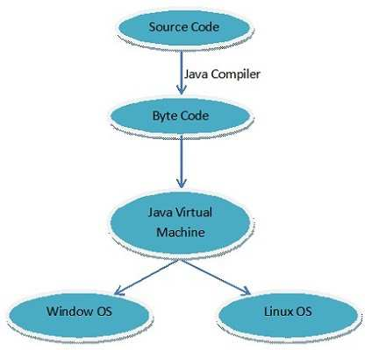
Why java is used - Java features -
Java is used because of following features.
1. Simple, easy and familiar: Java is easy to learn and familiar because java syntax is just like C++. It is simple because -
a) It does not use header files.
b) Eliminated the use of pointer and operator overloading.
2. Platform Independent: Write once, run anywhere (WORA)

Slide 17
3. Object-Oriented: Java is Object oriented throughout language- that mean no coding outside of class definitions, including main ().
4. Robust: Robust means inbuilt capabilities to handle errors/exceptions. Java is robust because of following – Built-in Exception handling.
Strong type checking i.e. all data must be declared an explicit type.
Local variables must be initialized.
Automatic garbage collection.
First checks the reliability of the code before Execution etc.
5. Secure: Java is secure because it provides -
Access restrictions with the help of access modifiers.
Byte codes verification – checks classes after loading.

Slide 18
Notes:
Class Loader – Confines objects to unique namespaces.
Security Manager – Determines what resources a class can access such as reading and writing to the local disk.
6. Distributed: Java provides the network facility. i.e. programs can be access remotely from any machine on the network rather than writing program on the local machine. HTTP and FTP protocols are
developed in java.
7. Compiled and interpreted: Java code is translated into byte code after compilation and the byte code is interpreted by JVM (Java Virtual Machine). This two steps process allows for extensive code checking and also increase security.
8. Portable: Means able to be easily carried or moved. Write once, run anywhere (WORA) feature makes it portable.

Slide 19
9. Architecture-Neutral: Java code is translated into byte code after compilation which is independent of any computer architecture; it needs only JVM (Java Virtual Machine) to execute.
10. High performance: JVM can execute byte codes (highly optimized) very fast with the help of Just in time (JIT) compilation technique.
11. Re-usability of code: Java provides the code reusability with the help of Inheritance.
12. Multithreading: Java provides multitasking facility with the help of lightweight processes called threads.
13. Dynamic: Java has the capability of linking dynamic new classes, methods and objects

Slide 20
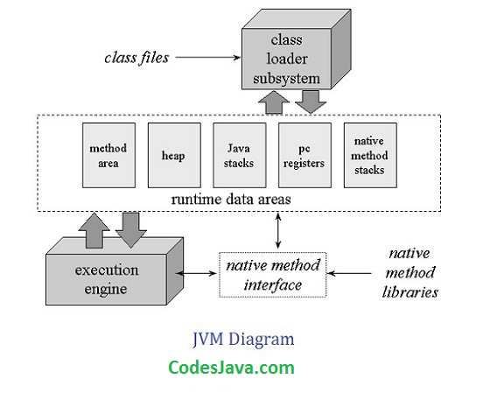
What is JVM?
JVM is a virtual machine or a program that provides run-time environment in which java byte code can be executed. JVMs are available for many hardware and software platforms. The use of the same byte code for all JVMs on all platforms make java platform independent.

Slide 21
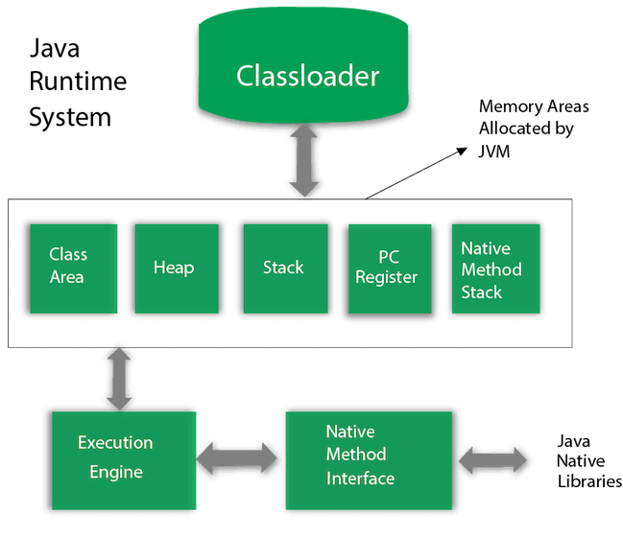
Java Structural Architecture

Slide 22
JVM provides definitions for the -
Memory area
Class file format
Register set
Garbage-collected heap
Fatal error reporting etc.
Notes:
“Write Once, Run Anywhere” (WORA) was the tagline for JAVA 1.0
After some successful updating, SUN launched new & different versions of Java for different purposes.
J2EE for Enterprise Edition (Server Side Programming)
J2ME for Mobile Application
J2SE for Standard Edition
The platform independent feature of Java is achieved by compiling the Java source code not to a machine code but to an intermediate code called byte codes. Byte codes are collection of instructions for JVM which are later interpreted to native codes.

Slide 23
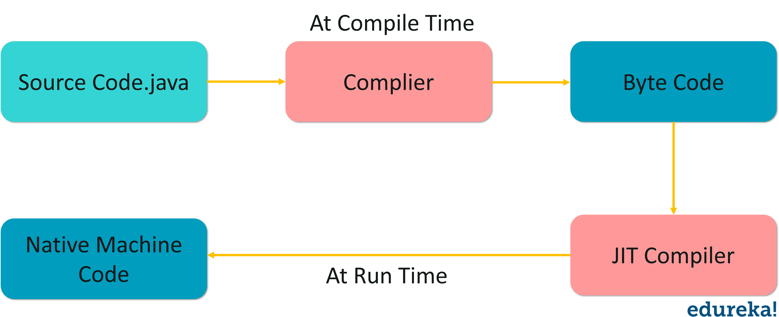
In GCJ compiler converts Java source codes to native machine codes resulting in faster execution of Java programs. When a Java file is compiled, a class file is created.
“Just In Time” (JIT) compiler is a solution to improve the performance.
A class file is merely collection of byte codes. Byte codes are then interpreted by a JVM but this interpretation is quite slow.

Slide 24
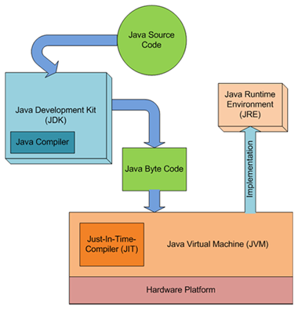

Slide 25
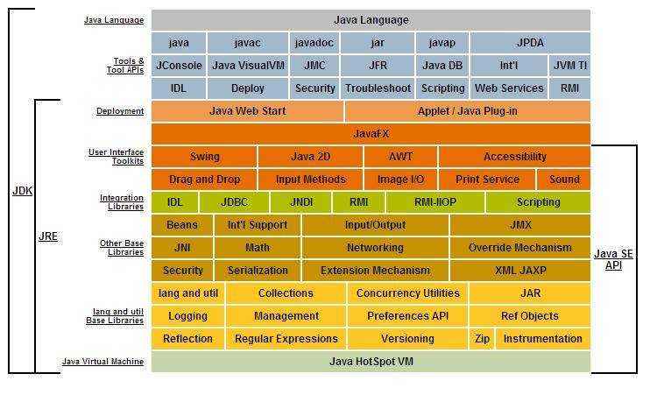

Slide 26
JVM detail Architecture -
1. Class loader subsystem: It is a part of JVM that care of finding and loading of class files.
2. Class/method area: It is a part of JVM that contains the information of types/classes loaded by class loader. It also contains the static variable, method body etc.
3. Heap: It is a part of JVM that contains object. When a new object is created, memory is allocated to the object from the heap and object is no longer referenced memory is reclaimed by garbage
collector.
4. Java Stack: It is a part of JVM that contains local variable, operands and frames. To perform an operation, Byte code instructions takes operands from the stack, operate and then return the result in to the java stack.

Slide 27
5. Program Counter: For each thread JVM instance provide a separate program counter (PC) or pc register which contains the address of currently executed instruction.
6. Native method Stack: As java program can call native methods (A method written in other language like c). Native method stack contains these native methods.
7. Execution Engine: It is a part JVM that uses Virtual processor (for execution), interpreter (for reading instructions) and JIT (Just in time) compiler (for performance improvement) to execute the instructions.

Slide 28
Class Loader –
Classloader is a subsystem of JVM which is used to load class files. Whenever we run the java program, it is loaded first by the classloader. There are three built-in classloaders in Java.
Bootstrap ClassLoader - This is the first classloader which is the super class of Extension classloader. It loads the rt.jar file which contains all class files of Java Standard Edition like java.lang package classes, java.net package classes, java.util package classes, java.io package classes, java.sql package classes etc.
Extension ClassLoader - This is the child classloader of Bootstrap and parent classloader of System classloader. It loads the jar files located inside $JAVA_HOME/jre/lib/ext directory.
System/Application ClassLoader - This is the child classloader of Extension classloader. It loads the classfiles from classpath. By default, classpath is set to current directory. We can change the classpath. It is also known as Application classloader.

Slide 29
public class ClassLoaderExample
{
public static void main(String[] args)
{
// Let's print the classloader name of current class.
Class c=ClassLoaderExample.class;
System.out.println(c.getClassLoader());
System.out.println(String.class.getClassLoader());
}
}
Note:
If we print the classloader name of String, it will print null because it is an in-built class which is found in rt.jar, so it is loaded by Bootstrap classloader.

Slide 30
How JVM is created (Why JVM is virtual)?
When JRE installed on your machine, you got all required code to create JVM. JVM is created when you run a java program.
Lifetime of JVM -
When an application starts, a runtime instance is created. When application ends, runtime environment destroyed. If n no. of applications starts on one machine then n no. of runtime instances are created and every application run on its own JVM instance.
Main task of JVM -
1. Search and locate the required files.
2. Convert byte code into executable code.
3. Allocate the memory into ram.
4. Execute the code.
5. Delete the executable code.

Slide 31
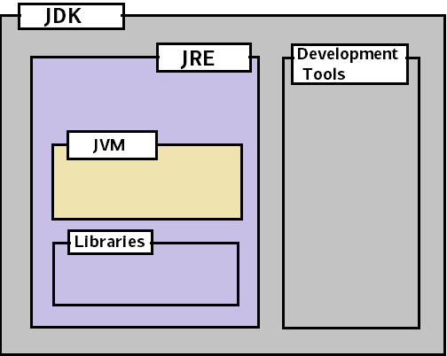
What is JRE (Java Runtime Environment)?
JVM + java runtime libraries + java package classes (e.g. util, lang etc). JRE provides class libraries and other supporting files with JVM. It not provide any development tool like compiler, debugger etc.
What do you mean by JDK (Java Development Kit)?
JRE + development tool (compiler, debugger etc.). JDK contains tools to develop the application and JRE to execute the application.

Slide 32
Comparison between C++ & Java
Comparison Index | C++ | Java
Platform-independent | Platform dependent | Platform independent
Mainly used for | System Programming | Application Development
Goto Statement | Support | Doesn’t Support
Multiple inheritance | Support | Doesn’t Support but can be achieved by Interface
Operator Overloading | Support | Doesn’t Support
Pointers | Support | Restricted
Compiler & Interpreter | Uses compiler only | Uses both
Call by Value & Call by Reference | Support both | Support only Call by Value
Structures & Union | Support | Doesn’t Support
Thread | Doesn’t Support | Support
Virtual Keyword | Support | Doesn’t Support
Hardware | Nearer to hardware | Not so closer to hardware
and many more…

Slide 33
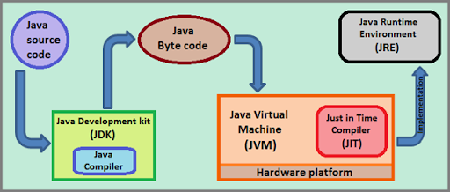
Java programs execution process using JDK

Slide 34
- Assignments -

Slide 35
Module – III: Data Concept
Sample program in Java
Explain –
The UNICODE character set
Tokens (Keywords, Identifiers, Literals & Constants etc.)
Variables
Declaring a variable
Dynamic Initialization of a variable
Data Type
Primitive Data Type
Non Primitive Data Type
Operators
Errors in Programming
Syntax Errors
Runtime Errors
Logical Errors

Slide 36
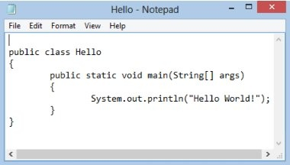
- WAP to print the statement “Hello World” -

Slide 37
- The UNICODE Character Set -
Character set is a set of valid characters that a language can recognize. A character represents letter, digit or any other special symbol. The Unicode is a 16-bit (2 byte) character set which can represent almost all human alphabets and writing systems around the world.
In the year 1993, the consortium of companies such as Apple, Microsoft, HP, Digital and IBM created the Unicode character set, using the ISO-10646 standard. Their aim was to produce a single standard.
This character set shares its first 256 values with the ISO-Latin character set. In addition to the characters of the ASCII character set, the Unicode character set defines an additional 65,280 distinct coded characters.
Unicode characters are using the escape sequence (\u), followed by a four digit hexadecimal number. For example –
\u00BD The fraction ½
\u00AE The copyright symbol
\u0022 The double quote etc.

Slide 38
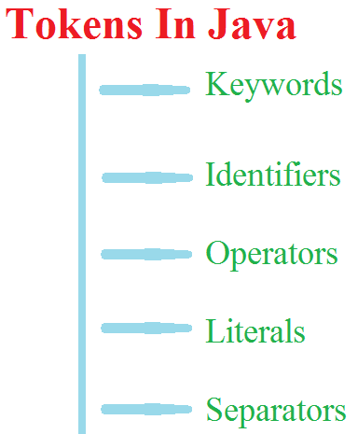
- Tokens -
The smallest individual unit in a program is known as token. Every java statement consists of individual words & punctuation marks which are known as tokens.
There are five types of tokens in java language – keywords, identifiers, literals, punctuators (or separators) and operators.

Slide 39
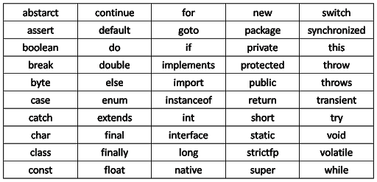
Keywords –
Java keywords are also known as reserved words. Keywords are particular words which acts as a key to a code. These are predefined words by Java so it cannot be used as a variable or object name.
A list of Java keywords or reserved words are given below –

Slide 40
Identifiers –
All Java components require names. Name used for classes, methods, interfaces and variables are called Identifier. Identifier must follow some rules. Here are the rules –
All identifiers must start with either a letter( a to z or A to Z ) or currency character($) or an underscore.
After the first character, an identifier can have any combination of characters.
A Java keyword cannot be used as an identifier.
Identifiers in Java are case sensitive.

Slide 41
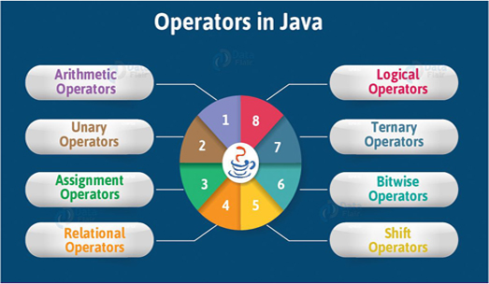
Operators –
Operator in Java is a symbol which is used to perform operations.
For example: +, -, *, / etc.
There are many types of operators in Java which are given below:
Unary Operator
Arithmetic Operator
Shift Operator
Relational Operator
Bitwise Operator
Logical Operator
Ternary Operator
Assignment Operator

Slide 42
Java Unary Operator -
The Java unary operators require only one operand. Unary operators are used to perform various operations i.e. –
incrementing/decrementing a value by one
negating an expression
inverting the value of a boolean
Java Unary Operator Example: ++ and --
class OperatorExample
{
public static void main(String args[])
{
int x=10;
System.out.println(x++);
System.out.println(++x);
System.out.println(x--);
System.out.println(--x);
}
}

Slide 43
Java Unary Operator Example: ~ and ! --
class OperatorExample
{
public static void main(String args[])
{
int a=10;
int b=-10;
boolean c=true;
boolean d=false;
System.out.println(~a);
System.out.println(~b);
System.out.println(!c);
System.out.println(!d);
}
}

Slide 44
Java Arithmetic Operators –
Java arithmetic operators are used to perform addition, subtraction, multiplication, division and modulo operations. They act as basic mathematical operations.
Java Arithmetic Operator Example –
class OperatorExample
{
public static void main(String args[])
{
int a=10;
int b=5;
System.out.println(a+b);
System.out.println(a-b);
System.out.println(a*b);
System.out.println(a/b);
System.out.println(a%b);
}
}

Slide 45
Java Arithmetic Operator Example: Expression –
class OperatorExample {
public static void main(String args[]) {
System.out.println(10*10/5+3-1*4/2);
}
}
Java Left Shift Operator -
The Java left shift operator << is used to shift all of the bits in a value to the left side of a specified number of times.
Java Left Shift Operator Example --
class OperatorExample {
public static void main(String args[]) {
System.out.println(10<<2);
System.out.println(10<<3);
System.out.println(20<<2);
System.out.println(15<<4);
}
}

Slide 46
Java Right Shift Operator –
The Java right shift operator >> is used to move left operands value to right by the number of bits specified by the right operand.
Java Right Shift Operator Example --
class OperatorExample
{
public static void main(String args[])
{
System.out.println(10>>2);
System.out.println(20>>2);
System.out.println(20>>3);
}
}

Slide 47
Java AND Operator Example: Logical && and Bitwise & -
The logical && operator doesn't check second condition if first condition is false. It checks second condition only if first one is true. The bitwise & operator always checks both conditions whether first condition is true or false.
class OperatorExample
{
public static void main(String args[])
{
int a=10;
int b=5;
int c=20;
System.out.println(a<b&&a<c); //false && true = false
System.out.println(a<b&a<c); //false & true = false
}
}

Slide 48
Java OR Operator Example: Logical || and Bitwise | -
The logical || operator doesn't check second condition if first condition is true. It checks second condition only if first one is false. The bitwise | operator always checks both conditions whether first condition is true or false.
class OperatorExample
{
public static void main(String args[])
{
int a=10;
int b=5;
int c=20;
System.out.println(a>b||a<c);
System.out.println(a>b|a<c);
}
}

Slide 49
Java Ternary Operator –
Java Ternary operator is used as one liner replacement for if-then-else statement and used a lot in Java programming. it is the only conditional operator which takes three operands.
Java Ternary Operator Example –
class OperatorExample
{
public static void main(String args[])
{
int a=2;
int b=5;
int min=(a<b)?a:b;
System.out.println(min);
}
}

Slide 50
Java Assignment Operator –
Java assignment operator is one of the most common operator. It is used to assign the value on its right to the operand on its left.
Java Assignment Operator Example –
class OperatorExample
{
public static void main(String args[])
{
int a=10;
int b=20;
a+=4;
b-=4;
System.out.println(a);
System.out.println(b);
}
}

Slide 51
Errors in Programming –
Error
Compile Time Error
Runtime Error
Latent Error
Syntax Error
Logical Error
Note: Latent Errors are the ‘hidden’ errors that occur only when a particular set of data is used.

Slide 52
Module – IV: Control Statements
Simple if statement
if…else statement
Nesting of if statement
switch statement

Slide 53
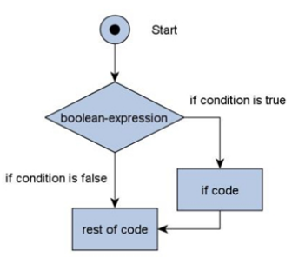
Simple if Statement - The Java if statement is the most simple decision-making statement. It is used to decide whether a certain statement or block of statements will be executed or not i.e. if a certain condition is true then a block of statement is executed otherwise not.
if(condition)
{
// Statements to execute if
// condition is true
}

Slide 54
Java program to illustrate If statement -
class IfDemo
{
public static void main(String args[])
{
int i = 10;
if (i < 15)
{
System.out.println("10 is less than 15");
}
}
}

Slide 55
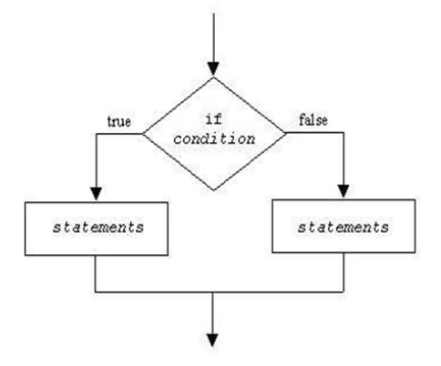
if…else statement - The if statement alone tells us that if a condition is true it will execute a block of statements and if the condition is false it won’t. But what if we want to do something else if the condition is false. Here comes the else statement. We can use the else statement with if statement to execute a block of code when the condition is false.
if (condition)
{
// Executes this block if
// condition is true
}
else
{
// Executes this block if
// condition is false
}

Slide 56
Java program to illustrate If…else statement -
class Test
{
public static void main(String args[])
{
int x = 30;
if( x < 20 )
{
System.out.print("This is if statement");
}
else
{
System.out.print("This is else statement");
}
}
}

Slide 57
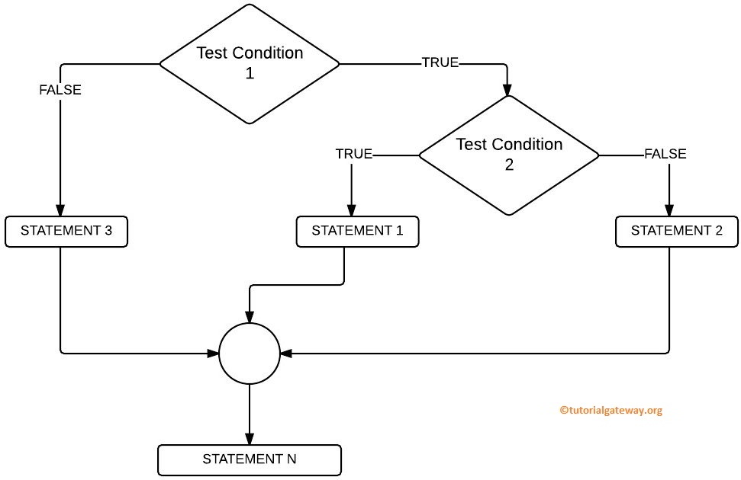
Nesting of if statement - It is always legal to nest if-else statements which means we can use one if or else if statement inside another if or else if statement.

Slide 58
Java program to illustrate nesting of if statement -
class Test
{
public static void main(String args[])
{
int x = 30;
int y = 10;
if( x == 30 )
{
if( y == 10 )
{
System.out.print ("X = 30 and Y = 10");
}
}
}
}

Slide 59
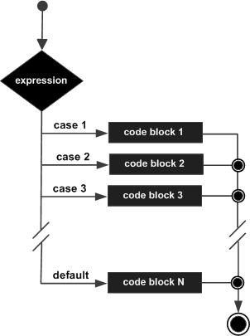
Switch Statement - In Java, the if..else..if ladder executes a block of code among many blocks. The switch statement can a substitute for long if..else..if ladders, which generally makes our code more readable.
switch(expression)
{
case value :
// Statements
break;
case value :
// Statements
break;
default : // Optional
// Statements
}

Slide 60
class SwitchExample
{
public static void main(String[] args)
{
int number=20;
switch(number)
{
case 10: System.out.println("10"); break;
case 20: System.out.println("20"); break;
case 30: System.out.println("30"); break;
default: System.out.println("Not in 10, 20 or 30");
}
}
}

Slide 61
Switch Case Statement Fall through - The Java switch statement is fall-through. It means it executes all statements after the first match if a break statement is not present.
class SwitchExample2
{
public static void main(String[] args)
{
int number=20;
switch(number)
{
case 10: System.out.println("10");
case 20: System.out.println("20");
case 30: System.out.println("30");
default: System.out.println("Not in 10, 20 or 30");
}
}
}

Slide 62
Module – V: Iteration Statements
For Loop
While Loop
Do-while Loop

Slide 63
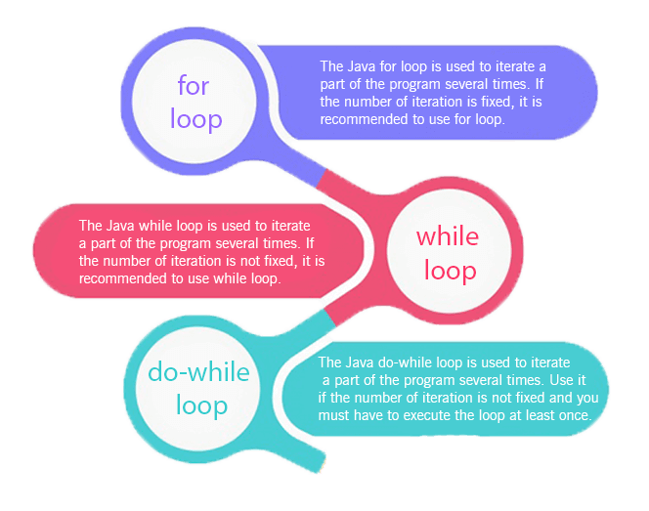

Slide 64
Comparison | for loop | while loop | do while loop
Introduction | The Java for loop is a control flow statement that iterates a part of the programs multiple times. | The Java while loop is a control flow statement that executes a part of the programs repeatedly on the basis of given boolean condition. | The Java do while loop is a control flow statement that executes a part of the programs at least once and the further execution depends upon the given boolean condition.
When to use | If the number of iteration is fixed, it is recommended to use for loop. | If the number of iteration is not fixed, it is recommended to use while loop. | If the number of iteration is not fixed and you must have to execute the loop at least once, it is recommended to use the do-while loop.
Syntax | for(init;condition;incr/decr){ // code to be executed } | while(condition){ //code to be executed } | do{ //code to be executed }while(condition);
Syntax for Infinitive loop | for(;;){ //code to be executed } | while(true){ //code to be executed } | do{ //code to be executed }while(true);

Slide 65
Module – VI: Arrays & Vector
1D Array
2D Array
Vector

Slide 66
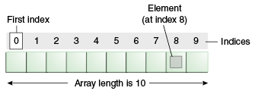
Java array is an object which contains elements of a similar data type. Additionally, The elements of an array are stored in a contiguous memory location. It is a data structure where we store similar elements. We can store only a fixed set of elements in a Java array.
Array in Java is index-based, the first element of the array is stored at the 0th index, 2nd element is stored on 1st index and so on.
In Java, array is an object of a dynamically generated class. Java array inherits the Object class, and implements the Serializable as well as Cloneable interfaces.
Java provides the feature of anonymous arrays which is not available in C/C++.

Slide 67
Advantages -
Code Optimization: It makes the code optimized, we can retrieve or sort the data efficiently.
Random access: We can get any data located at an index position.
Disadvantages -
Size Limit: We can store only the fixed size of elements in the array. It doesn't grow its size at runtime.
Note: To solve this problem, collection framework is used in Java which grows automatically.
Types of Array in Java -
Single Dimensional Array
Multidimensional Array
Single Dimensional Array
Syntax to Declare an Array in Java - dataType arr[];
Instantiation of an Array in Java - datatype arrayRefVar=new datatype [size];

Slide 68
Java Program to illustrate how to declare, instantiate, initialize and traverse the Java array.
class Testarray
{
public static void main(String args[])
{
int i;
int a[]=new int[5];
a[0]=10;
a[1]=20;
a[2]=70;
a[3]=40;
a[4]=50;
for(i=0; i<a.length; i++)
System.out.println(a[i]);
}
}

Slide 69
Declaration, Instantiation and Initialization of Java Array
class Testarray1
{
public static void main(String args[])
{
int a[]={33,3,4,5};
for(int i=0;i<a.length;i++)
System.out.println(a[i]);
}
}

Slide 70
For-each Loop for Java Array
class Testarray1
{
public static void main(String args[])
{
int arr[] = {33,3,4,5};
for(int i : arr)
{
System.out.println(i);
}
}
}

Slide 71
Passing Array to a Method in Java
class Testarray2
{
public static void min(int arr[])
{
int min=arr[0];
for(int i=1; i<arr.length; i++)
{
if(min>arr[i])
{
min=arr[i];
}
}
System.out.println(min);
}
public static void main(String args[])
{
int a[]={33,3,4,5};
min(a);
}
}

Slide 72
Anonymous Array in Java
Java supports the feature of an anonymous array, so we don't need to declare the array while passing an array to the method.
class TestAnonymousArray
{
static void printArray(int arr[])
{
for(int i=0;i<arr.length;i++)
{
System.out.println(arr[i]);
}
}
public static void main(String args[])
{
printArray(new int[]{10,22,44,66});
}
}

Slide 73
Returning Array from the Method
class TestReturnArray
{
static int[] get()
{
return new int[]{10,30,50,90,60};
}
public static void main(String args[])
{
int arr[]=get();
for(int i=0;i<arr.length;i++)
{
System.out.println(arr[i]);
}
}
}

Slide 74
Multidimensional Array in Java -
In such case, data is stored in row and column based index (also known as matrix form).
Syntax to Declare Multidimensional Array in Java - dataType arrayRefVar[][];
Example to instantiate Multidimensional Array in Java - int arr[][]=new int[3][3];
class Testarray3
{
public static void main(String args[])
{
int arr[][]={{1,2,3},{2,4,5},{4,4,5}};
for(int i=0;i<3;i++)
{
for(int j=0;j<3;j++)
{
System.out.print(arr[i][j]+" ");
}
System.out.println();
}
}
}

